Slide 1
Methods in spatialtemporal approach
Fei

Slide 2
Temporal feature measurement
Autocorrelation window (ACW)
Autocorrelation function (ACF)

Slide 3
Autocorrelation window
Autocorrelation function is the correlation of a signal with shifted (time-lagged) versions of itself
Autocorrelation function yields a series of numbers, different studies report slightly different properties of it
EEG/MEG studies define ACW as the time lag the correlation reaches half of its maximum value or when it reaches 1⁄e (Golesorkhi et al. defines a new variant called ACW-0)

Slide 4
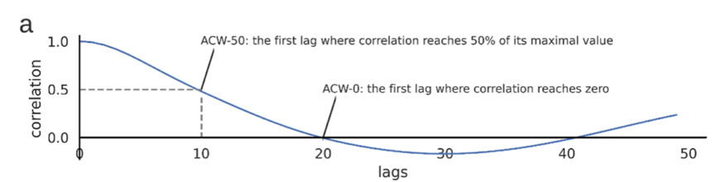
Autocorrelation window
ACW is defined as the first lag in which the correlation of the signal with itself drops below 50% of the maximum correlation. It is measured from the autocorrelation function

Slide 5
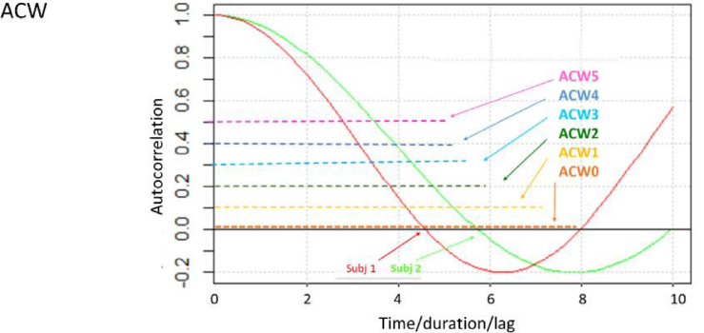
Autocorrelation window

Slide 6
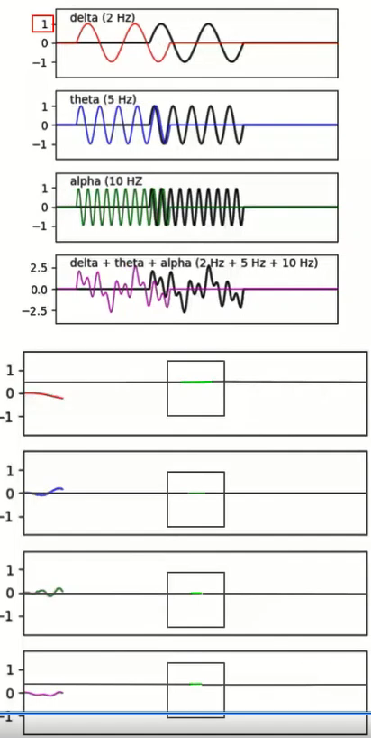

Slide 7
ACW: summery
ACW measures temporal integration in the time domain by way of correlations across different time points
To compute the ACW, first an autocorrelation function is constructed by correlating a time series with copies of itself, shifted in time with various lags
This results in a correlation as a function of time lag
The autocorrelation is one at lag zero, and decays at larger lags as the shifted copies become less correlated with the original
Longer ACW is related to slow frequencies while shorter ACW is modulated by stronger power in faster frequencies

Slide 8
ACW: summery
ACW values represent the extent of the periodicity of the EEG signal, whereby longer ACWs can be interpreted as greater stability of the signal over time
The length of the ACW can be seen, therefore, as an index that summarizes the degree of regularity of a signal, with longer ACW associated with more a regular EEG signal
Notes:
The “width” of the autocorrelation function (i.e., the lag value at which the autocorrelation function reaches 0.5) measures how consistent the time series is from time point to time point

Slide 9
Sample entropy
SampEn

Slide 10
Entropy
Entropy was originally used in thermodynamics to measure the distribution probability of molecules
For example, molecules have fewer opportunities to move in a crystal than in a liquid
The unrestricted movement of the molecules in a liquid displays a higher entropy as well as more chaotic behaviour

Slide 11
Entropy
Entropy can be implied in signal analysis, measuring the regularity of a time series by evaluation the appearance of repetitive patterns
To quantify how regular or chaotic is in that time series
Entropy value ↑ : more irregular/unpredictable/chaotic/disorder signal
Entropy value ↓ : more regular/predictable/order signal
Entropy can be used to measure the level of chaos of the system. Higher entropy indicates more complex system
It is a nonlinear measure quantifying the degree of complexity in a time series

Slide 12
Entropy
Sometimes in the time series data, if we see mean, variance and standard variance, we will miss important information
Time series 1: (1,2,1,2,1,2,1,2,1,2,...)
Time series 2: (1,1,2,1,2,2,2,2,1,1,...)
Their mean, variance and median are almost the same, but entropy are different
Entropy of time series 2 is higher than time series 1
Time series 1 has repetitive pattern/ self-similarity pattern

Slide 13
Approximate entropy (ApEn)
ApEn is a parameter that measures sequential and temporal regularity/irregularity in a series
ApEn examines time series for similar epochs
Low ApEn values reflect that the series is regular, repetitive and predictable, with patterns that repeat throughout of the series
High ApEn values mean that the series is irregular and unpredictable, with a low number of repeated patterns
ApEn bias: self-matching problem
Notes:
https://en.wikipedia.org/wiki/Approximate_entropy
https://www.youtube.com/watch?v=5vOYgJ-80Bg&ab_channel=RamiKhushaba

Slide 14
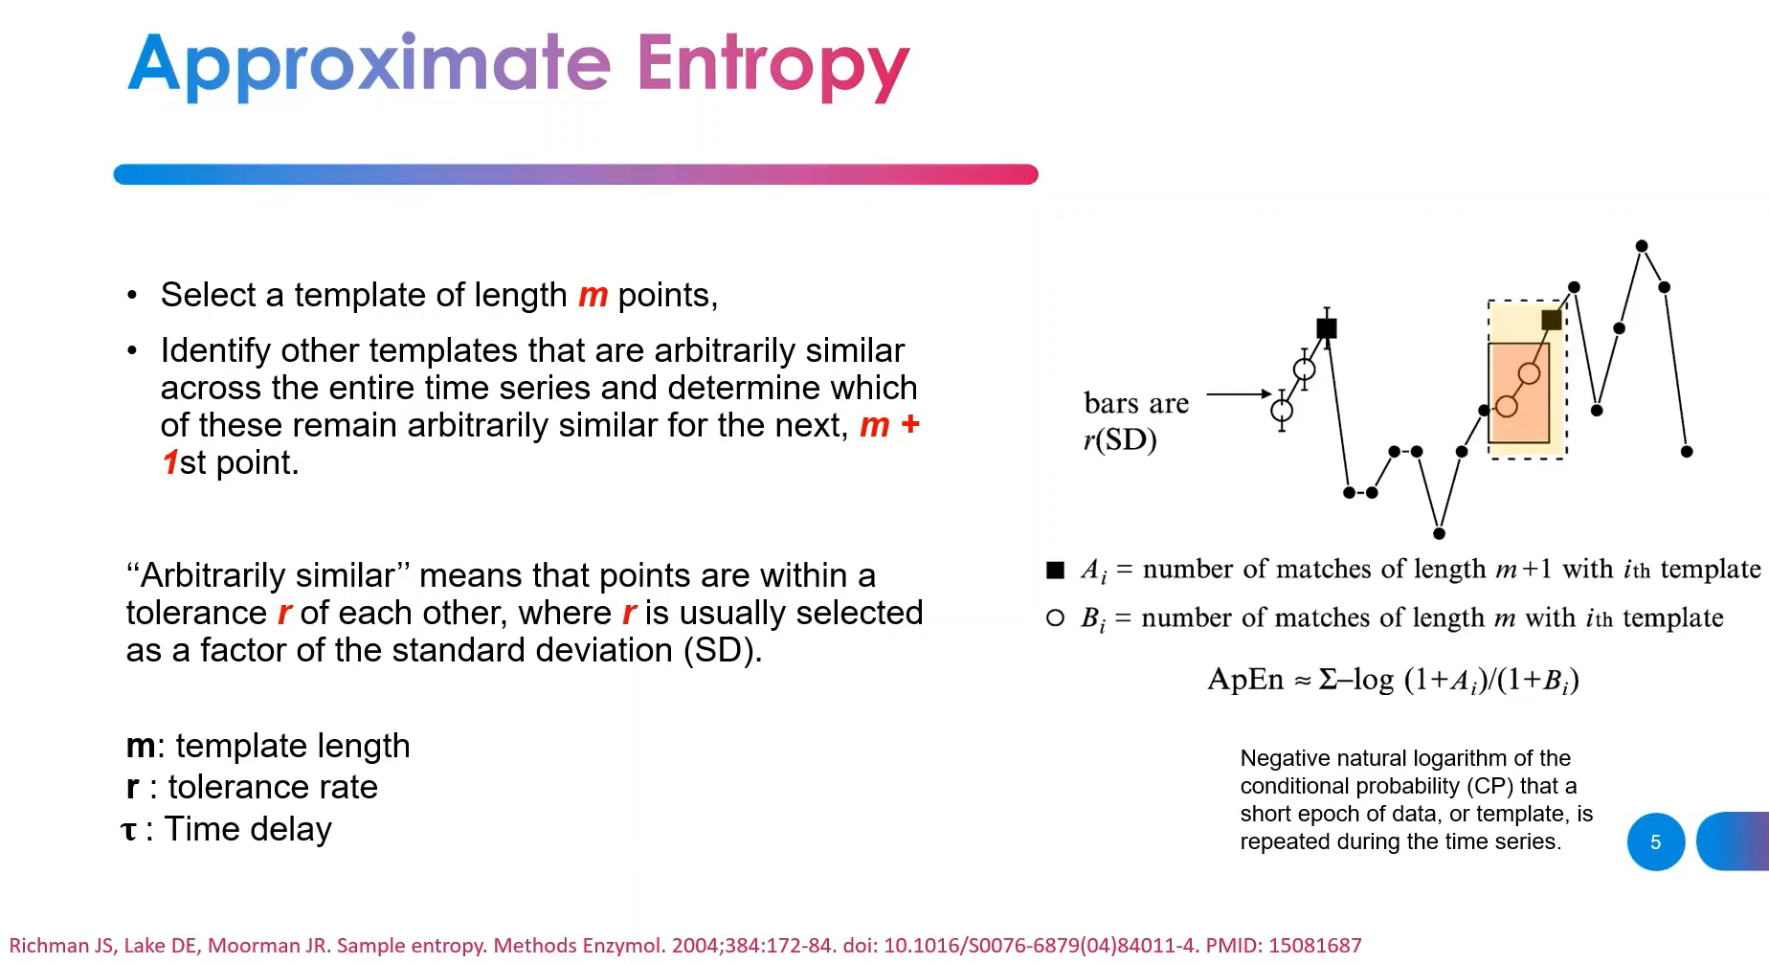
Notes:
If we want to see how repeatable is that pattern, we have to have some similarity measure and some threshold on similarity
m is the length of sequences to be compared
r is the tolerant threshold of a accepting matches
Given a time series x = [x1, x2, … ,xN] with length N
It is convenient to set tolerant threshold as r SD, where SD is the standard deviation of the original time series??

Slide 15
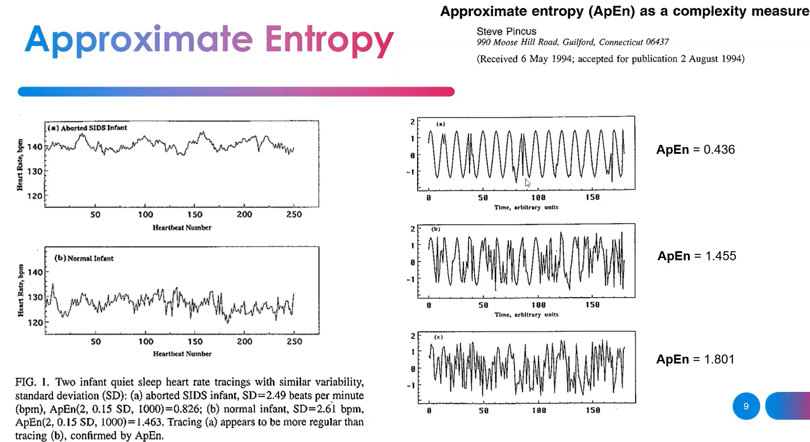
Notes:
https://www.youtube.com/watch?v=5vOYgJ-80Bg&ab_channel=RamiKhushaba

Slide 16
Sample entropy (SampEn)
Solving the self-matching problem to eliminate the ApEn bias
SampEn is largely independent of record length and displays relative consistency under circumstances where ApEn does not
To estimate the randomness of a series of data without any previous knowledge about the source generating the dataset
SampEn method is defined as the negative of the natural logarithm of the conditional probability that sequences which close to each other within a threshold r for m consecutive data points remain close to each other when adding one more point to each sequence

Slide 17
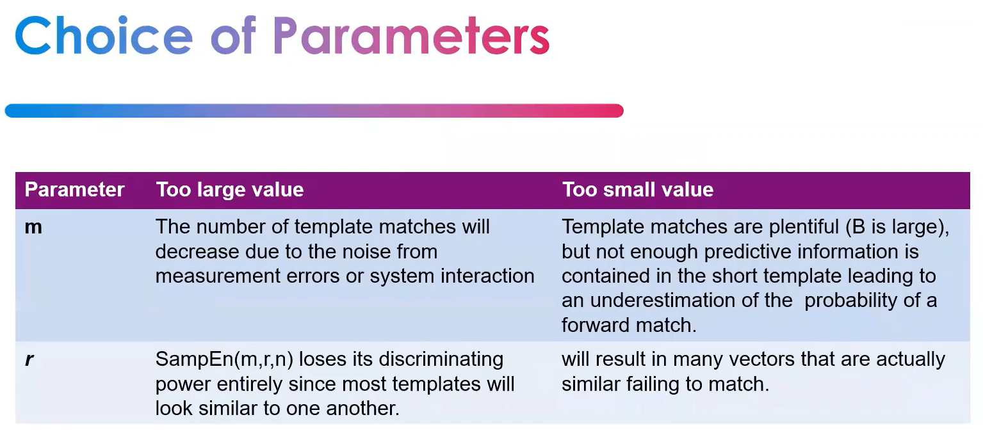
Notes:
https://www.youtube.com/watch?v=5vOYgJ-80Bg&ab_channel=RamiKhushaba

Slide 18
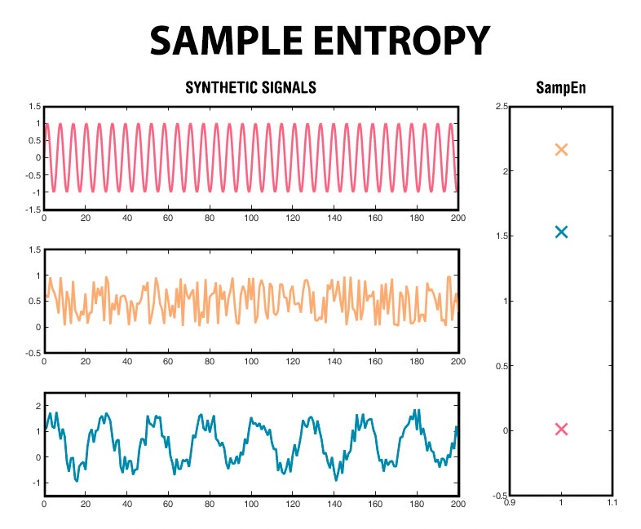

Slide 19
References
Olbrys, J., & Majewska, E. (2022). Approximate entropy and sample entropy algorithms in financial time series analyses. Procedia Computer Science, 207, 255-264.
Delgado-Bonal, A., & Marshak, A. (2019). Approximate entropy and sample entropy: A comprehensive tutorial. Entropy, 21(6), 541.

Slide 20
References
Jia, Y., Gu, H., & Luo, Q. (2017). Sample entropy reveals an age-related reduction in the complexity of dynamic brain. Scientific reports, 7(1), 7990.
Courtiol, J., Guye, M., Bartolomei, F., Petkoski, S., & Jirsa, V. K. (2020). Dynamical mechanisms of interictal resting-state functional connectivity in epilepsy. Journal of Neuroscience, 40(29), 5572-5588.
Coppola, P., Spindler, L. R., Luppi, A. I., Adapa, R., Naci, L., Allanson, J., ... & Stamatakis, E. A. (2022). Network dynamics scale with levels of awareness. Neuroimage, 254, 119128.
Cruzat, J., Herzog, R., Prado, P., Sanz-Perl, Y., Gonzalez-Gomez, R., Moguilner, S., ... & Ibañez, A. (2023). Temporal irreversibility of large-scale brain dynamics in Alzheimer’s disease. Journal of Neuroscience, 43(9), 1643-1656.

Slide 21
Lempel-Ziv complexity
(LZC)

Slide 22
LCZ
The Lempel-Ziv complexity is another measure to determine the complexity of brain mechanisms
LZC proposed by Lempel and Ziv is a nonparametric method to evaluate complexity (randomness) of finite sequences
This measure is used to determine the complexity or compressibility of a sequence (Lempel & Ziv, 1976)
Lempel–Ziv complexity measures the generation rate of new patterns along a digital sequence
Notes:
Szczepański, J., Amigó, J. M., Wajnryb, E., & Sanchez-Vives, M. V. (2004). Characterizing spike trains with Lempel–Ziv complexity. Neurocomputing, 58, 79-84.

Slide 23
LCZ: Calculation
Two steps
The value of a given signal of length is binarised
The standard way of doing this is calculating its mean value and turning each data point above it to 1s and each point below it to 0s; however, other possibilities have also been used (thresholding over the median, using the Hilbert transform, etc…)
The resulting binary sequence is scanned sequentially looking for distinct structures or patterns, building up a dictionary that summarises the sequences seen so far
Notes:
When and how to use Lempel-Ziv complexity
https://information-dynamics.github.io/complexity/information/2019/06/26/lempel-ziv.html
Regular signals can be characterized by a small number of patterns and hence have low LZ complexity, while irregular signals require long dictionaries and hence have a high LZ complexity
A signal is regarded as complex if it is not possible to provide a brief (i.e. compressed) representation of it

Slide 24
LCZ: Calculation
Finally, the LZ index is determined by the length of this dictionary; i.e., is the number of distinct patterns found
For example
S = '10101010' → S = 1．0 ．101010，c = 3
S = '1001111011000010' → 1．0．01．1110．1100．0010，c = 6
LZC = c/b，b = length(x)/log2(length(x))
Notes:
https://perso.crans.org/besson/publis/Lempel-Ziv_Complexity.git/Short_study_of_the_Lempel-Ziv_complexity.html
(Be careful this website has some wrong examples!)

Slide 25
LCZ
In EEG, LCZ is a non-parametric estimator that divides finite EEG signal sequences into binary sequences
The EEG sequence is divided into binary numbers and compared with a median or mean
The median or mean threshold is an averaging of window time series, by which the original signal is compared and classified
In terms of microstate sequences the threshold mean or median value, would be the microstate time window duration
The sequence is assigned to a 1 if the sequence is greater than the mean or median and to a 0 if the sequence is smaller than the mean or median

Slide 26
LCZ
The resulting binary sequence is scanned sequentially looking for distinct structures or patterns (from left to righ), building up a dictionary that summarises the sequences seen so far
The complexity measure increases by one unit when a novel partial sequence pattern is found
A signal is regarded as complex if it is not possible to provide a brief (i.e. compressed) representation of it

Slide 27
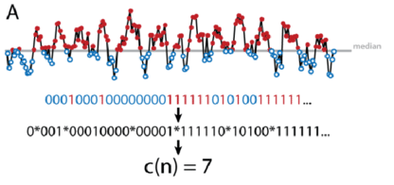
LCZ: EEG example
https://www.researchgate.net/figure/Comparison-of-Lempel-Ziv-and-multiscale-entropy-analysis-A-Lempel-Ziv-complexity_fig1_324601631

Slide 28
LZC MEG example
In this work, we convert the MEG signal x = [x1, x2, …., xN] into a binary sequence
Notes:
An example showing how to transform a segment of time series into a binary sequence by threshold and the results of LZC calculation

Slide 29
LCZ: summery
The LCZ measure shows the rate at which new patterns appear with respect to the underlying system regardless of whether the system is deterministic or stochastic
→ It indicates how many additions or new patterns are present in the sequence
A higher complexity, the more complex the signal, suggests more additions, more new patterns, and a weaker periodicity in the given symbol sequence → thus a more complex dynamic behavior
A lower complexity indicates more duplication, fewer new patterns, and a stronger periodicity

Slide 30
LCZ: summery
Rate of New Patterns
A higher complexity suggests that new patterns emerge quickly over time. This means that the data is changing rapidly and is characterized by disorder and complexity
A lower complexity indicates a slower rate of new patterns, suggesting more regularity and periodicity in the data
→ A lower complexity indicates more duplication, fewer new patterns, and a stronger periodicity

Slide 31
LCZ: summery
Reflecting System Changes
The LCZ is often used to reflect how a system’s state changes over time
It can describe whether a system's behavior is characterized by frequent and unpredictable changes (high complexity) or whether it follows a more ordered and periodic pattern (low complexity)
Therefore, calculating the complexity of a time series is a crucial way to understand how a system evolves and changes

Slide 32
References
https://www.dlnu.edu.cn/xintong/docs/20121128144202794986.pdf (Chinese)
Shumbayawonda, E., Tosun, P. D., Fernández, A., Hughes, M. P., & Abásolo, D. (2018). Complexity changes in brain activity in healthy ageing: a permutation Lempel-Ziv complexity study of magnetoencephalograms. Entropy, 20(7), 506.
Borowska, M. (2021). Multiscale permutation lempel–ziv complexity measure for biomedical signal analysis: Interpretation and application to focal eeg signals. Entropy, 23(7), 832.
“The original Lempel–Ziv complexity algorithm consists of transformation of the signal into a binary sequence by comparing it with the threshold (e.g., mean or median) and calculating the unique subsequence in a sequence”

Slide 33
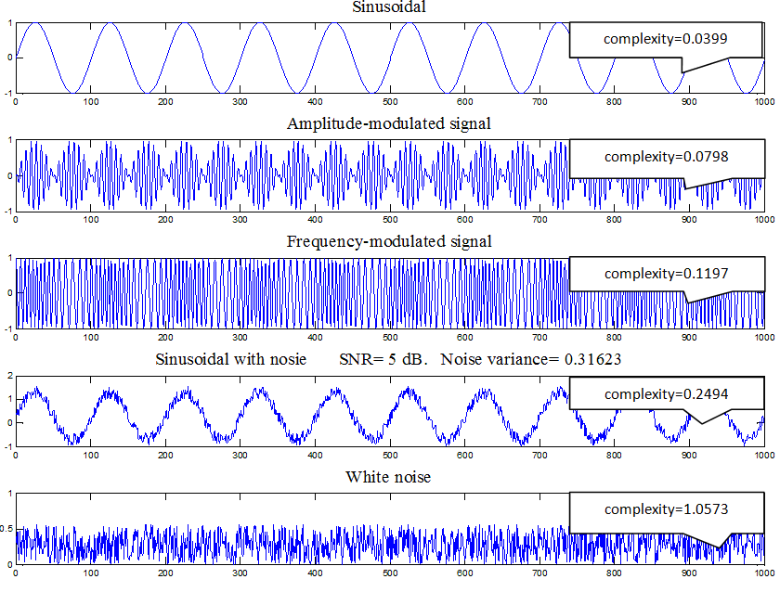
Lempel-Ziv index values of different simulation of signals A magnetic plug installed in the oil feedback pipe collects debris from the oil as evidence of bearing degradation.
Notes:
Jiang, K., Xu, G., Liang, L., Zhao, G., & Tao, T. (2012). 911. A quantitative diagnosis method for rolling element bearing using signal complexity and morphology filtering. Journal of vibroengineering, 14(4).

Slide 34
Similar between sample entropy and LCZ
Both sample entropy and Lempel-Ziv complexity are measures complexity of signal
However, sample entropy is used for assessing the regularity or irregularity of continuous time series data, while Lempel-Ziv complexity is used for analyzing the complexity and compressibility of discrete data sequences after symbolization.

Slide 35
Difference between sample entropy and LCZ
 | Sample entropy | LCZ
Purpose | To assess the complexity or irregularity of time series data | To evaluate the complexity or compressibility of a sequence of symbols or time series data after symbolization
 | To quantifie the likelihood that similar patterns of data points will remain similar as the data series is extended | To focus on identifying patterns and redundancy in data and assessing the compressibility or complexity of the sequence

Slide 36
Difference between sample entropy and LCZ
 | Sample entropy | LCZ
Data type | The data is typically not discretized into symbols before applying sample entropy | The continuous data is typically discretized into symbols, and the complexity analysis is performed on these symbols
Calculation Method | To measure the likelihood that data points within a specified window are repeated within a similar window as the data series is extended It is based on comparing sequences of data points within the same time series | To find repeated patterns (substrings) within a symbolized data sequence It calculates the number of unique substrings and is based on the idea of data compression

Slide 37
Intra subject variability

Slide 38
Intra subject variability
To understand the degree of variability or inconsistency in measurements or observations taken from the same individual over a period of time
It refers to the differences or fluctuations in data points obtained from a single subject or participant within a study or experiment

Slide 39
Intra subject variability
It focuses on the variation observed within a single individual across multiple measurements, sessions, or time points
It is concerned with how much an individual's responses or measurements fluctuate when assessed repeatedly
Variability can be seen at many levels: intra-subject refers to the difference found in the same subject in multiple repetitions of the same task
Notes:
Zhao, K., Zhang, Z., Wen, H., & Scano, A. (2021). Intra-subject and inter-subject movement variability quantified with muscle synergies in upper-limb reaching movements. Biomimetics, 6(4), 63.

Slide 40

Intra subject variability
Standard Deviation (SD)
Coefficient of Variation (CV): CV = (Standard Deviation / Mean) 。 CV(%) = SD/Mean x 100
For log-normal data, the following modified formula is a more accurate estimator (Koopmans et al., 1964):
Where s_{ln} is the standard deviation of the natural logarithm of the original data
Notes:
Wainio-Theberge, S., Wolff, A., Gomez-Pilar, J., Zhang, J., & Northoff, G. (2022). Variability and task-responsiveness of electrophysiological dynamics: scale-free stability and oscillatory flexibility. NeuroImage, 256, 119245.

Slide 41
Temporal feature in resting-state fMRI
Power-Law Exponent (PLE)

Slide 42
Power-Law Exponent (PLE)
fMRI, EEG and MEG show that spontaneous brain activity can be characterized by scale-free dynamics
The properties of scale-free dynamics are shared by many systems found in nature, and also are observed in neural activity across different spatiotemporal scales: from neurotransmitter release, neuronal spike trains, network firing rates, field potentials to fMRI signals
Scale-free dynamics can be revealed by scaling analysis, with which the fluctuations of a parameter as a function of the scale at which the parameter is evaluated can be quantified

Slide 43
Power-Law Exponent (PLE)
Furthermore, the scale-free dynamics of brain activity can be indexed using the power-law exponent (PLE), that is, the power spectrum with the formula power ∝ 1/frequency β, where β is the PLE
PLE is considered a suitable measure for the scale-free dynamics of fMRI data, as it gives specific information on the relationship between slower and faster frequencies with low computational cost
Among the different methods for computing fMRI time series complexity, Rubin and colleagues (Rubin et al., 2013) demonstrated power spectrum based methods such as PLE to be among the most robust measures

Slide 44
Power-Law Exponent (PLE)
To obtain PLE, the fMRI signal (the time course per voxel) is normalized to zero mean and unit variance (z-value) (Stephens et al., 2013) and then transpose to the frequency domain using a Fast Fourier Transform
The power spectrum is further smoothed with a Hamming Window (HW) of 7 neighboring frequency bins (HW=7)
Power spectra can be averaged across all the voxels within a certain region of interest (ROI)
Notes:
PLE was defined as the slope of the linear regression of log power on log frequency

Slide 45
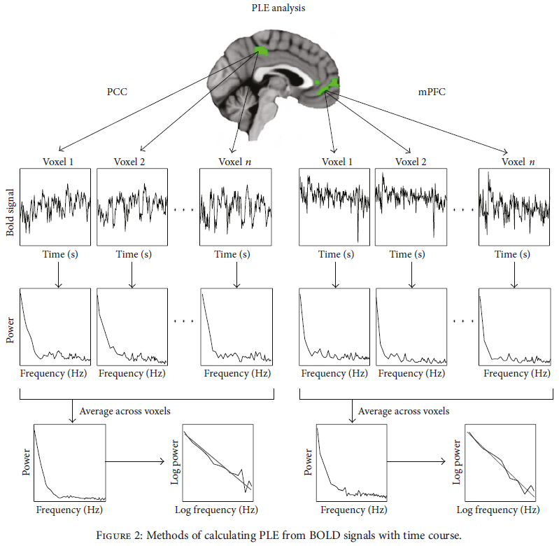
PLE
The power spectrum was fitted with a power-law function P ∝ 1/f ^{β} using a least square estimation (in a log frequency by log power plot)
The PLE of each subject's regions was defined as the absolute value of the slope of the linear regression of log-power on log-frequency

Slide 46
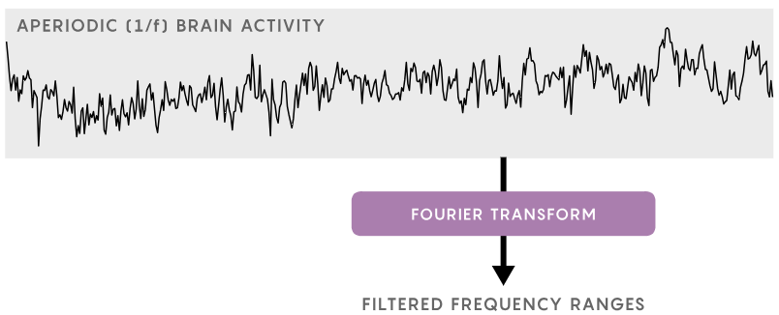
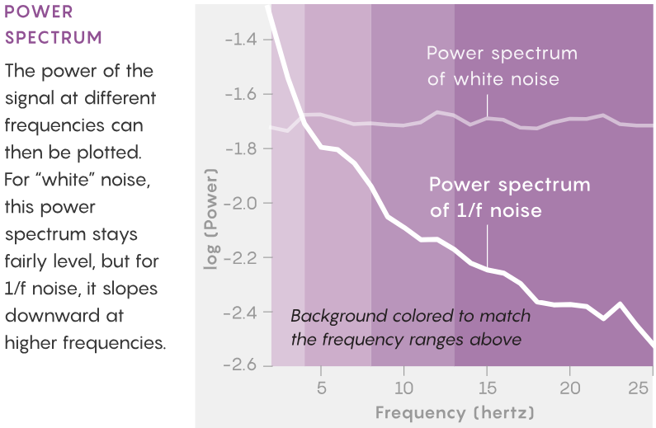
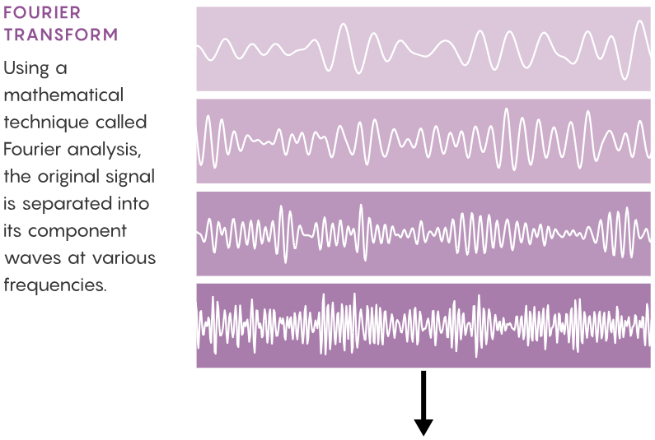
Slow
Fast

Slide 47
Reference
The "1/f" structure of spectral brain dynamics
https://www.youtube.com/watch?v=ToZFyIvnQnI&list=RDCMUCUR_LsXk7IYyueSnXcNextQ&index=2&ab_channel=MikeXCohen

